Slide 1

Visual Analytics Project - Team Eywa
Devasthali, Kimaya; Eagapati, Indrani; Makthala, Prathik

Slide 2
Agenda
Introduction
Dataset
Problem Description
Data Exploration
Visualization
Other Interesting Insights
Employee Patterns
Analysis
Anomalies
Observed Relationships
Conclusion
Future Scope

Slide 3

Introduction
GAStech’s relocation into a new and modern premises in Abila, Kronos.
High energy efficiency standards alongside HVAC system calibration issues.
Strategic positioning of expensive but limited hazium sensors.
Proximity cards are being used as part of a security upgrade.
"Rosie" an automatic robotic mail system that has built-in prox card detecting capabilities is introduced.

Slide 4

Dataset
Dataset - VAST 2016 Challenge Dataset
Building layout and map of the new GASTech Offices and its employee data.
Data from Proximity Sensors and HVAC (heating,ventilation and air conditioning)sensor readings.
Maps of the HVAC sensor zones proximity sensor zones.
Hazium readings from four sensors.
Proximity sensor readings from Rosie

Slide 5
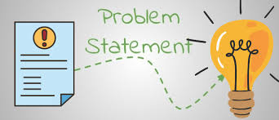
Problem Description
Goal: Study data to analyze potential suspicious activity.
Study and Visualize data to gain insights on possible correlations and anomalies.
Questions to Ponder:
What are the typical patterns observed in the sensors - prox cards and HVAC?
Have there been any unusual events?
Have there been any suspicious activities?
Any relationships observed in Building, HVAC and Employee proximity data?

Slide 6
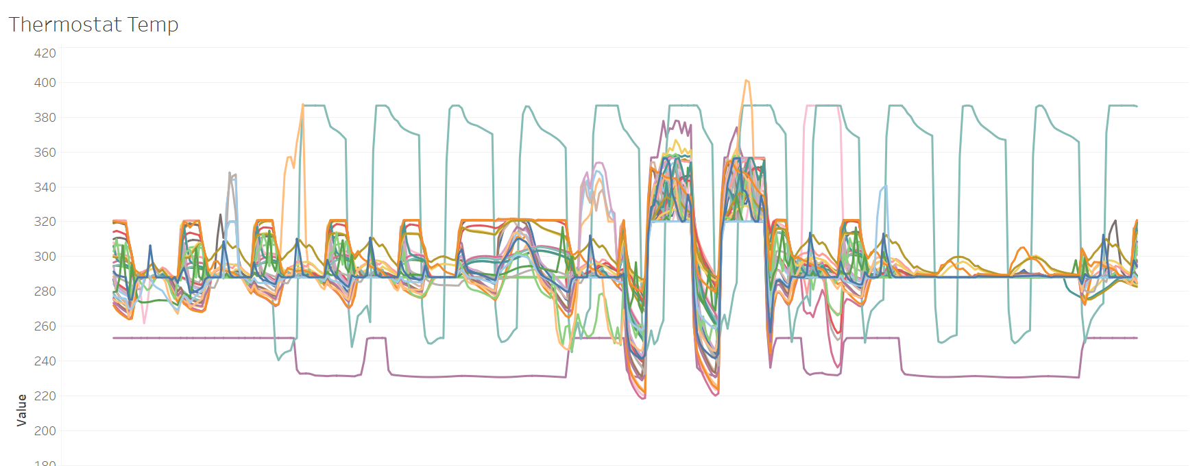
Data Exploration
Data includes sensor and HVAC data from the building.
Insights like Power consumption, Heat, Gas Concentration, Air & Water flow readings etc.
Power consumption is an important factor.
Hazium Readings for 4 zones with Hazium sensors. Can be compared to CO2 readings.
Other readings could also give some interesting insights.

Slide 7
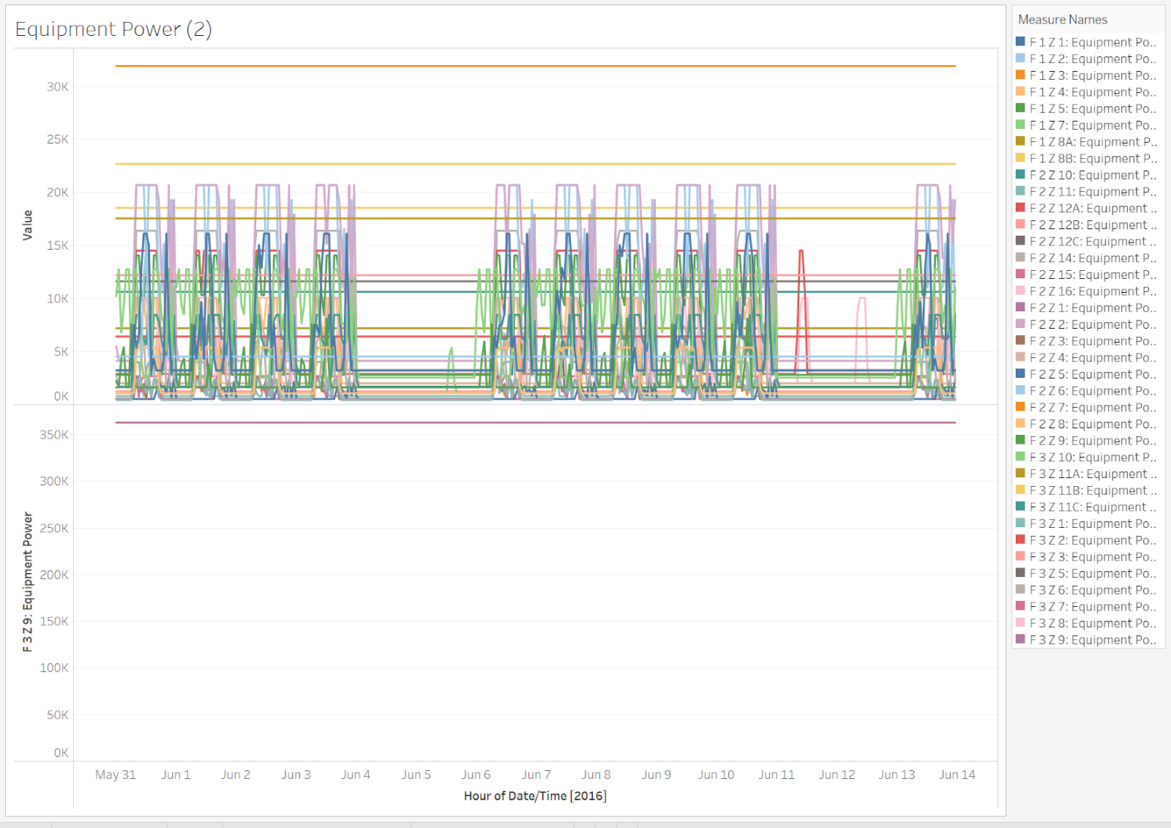
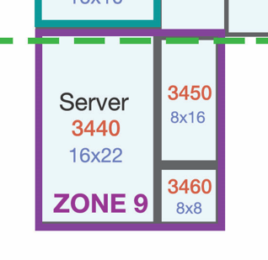
Visualization - Equipment Power
Equipments Power Consumption by Zone - F 3 Z 9 has 10x higher consumption.

Slide 8
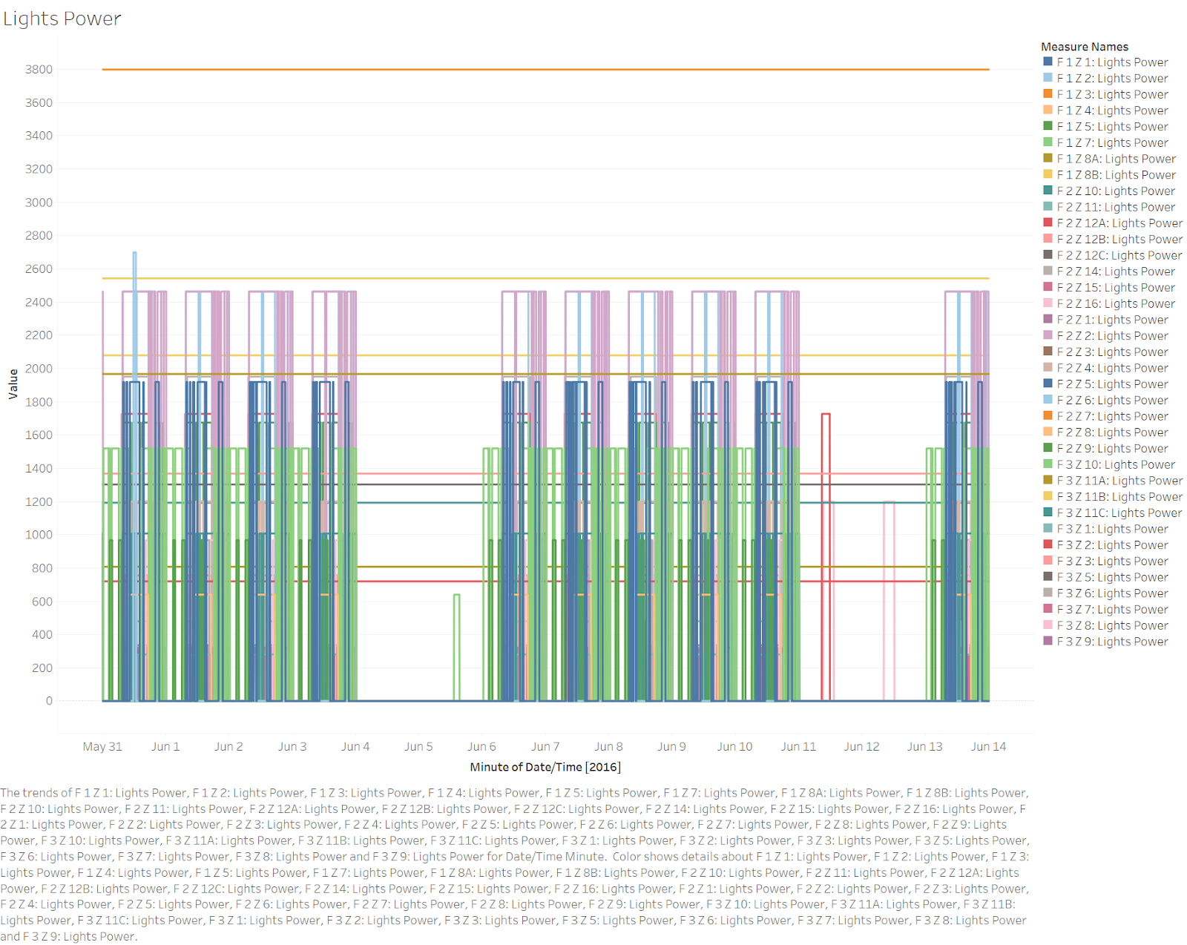
Visualization - Light Power
Light Power Consumption by Zone

Slide 9
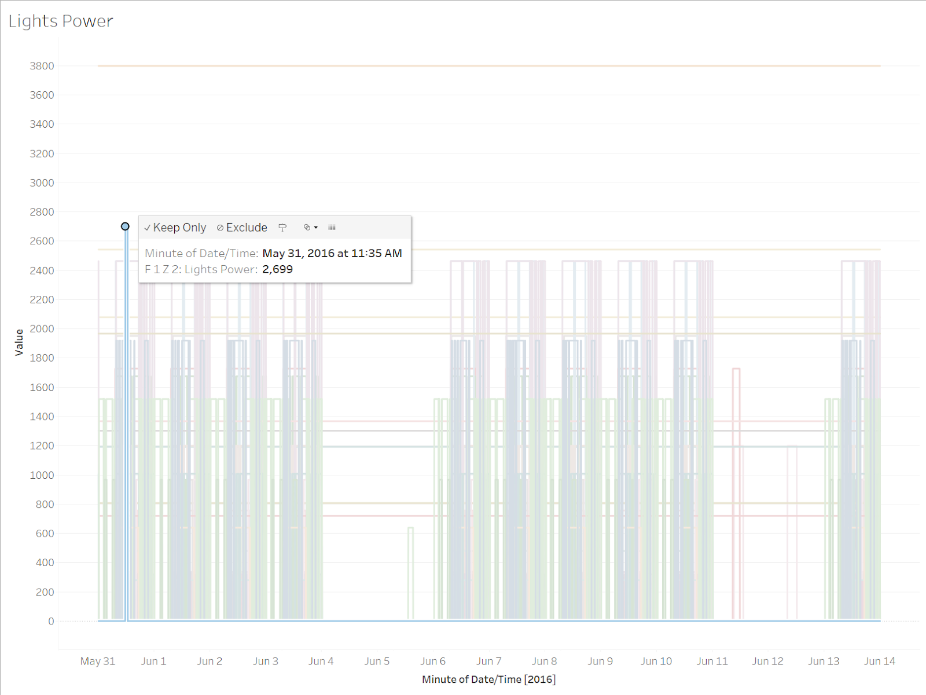
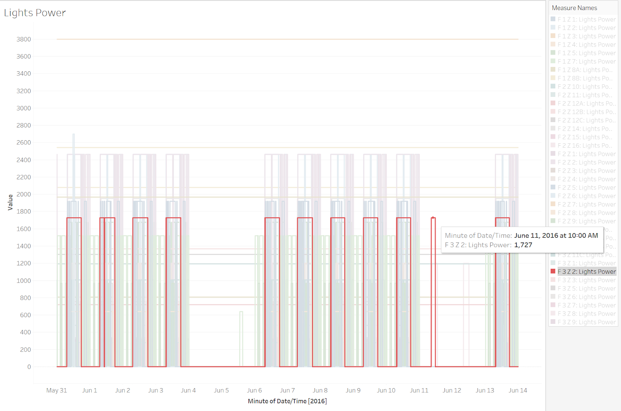
Visualization - Light Power
Light Power Consumption by Zone

Slide 10
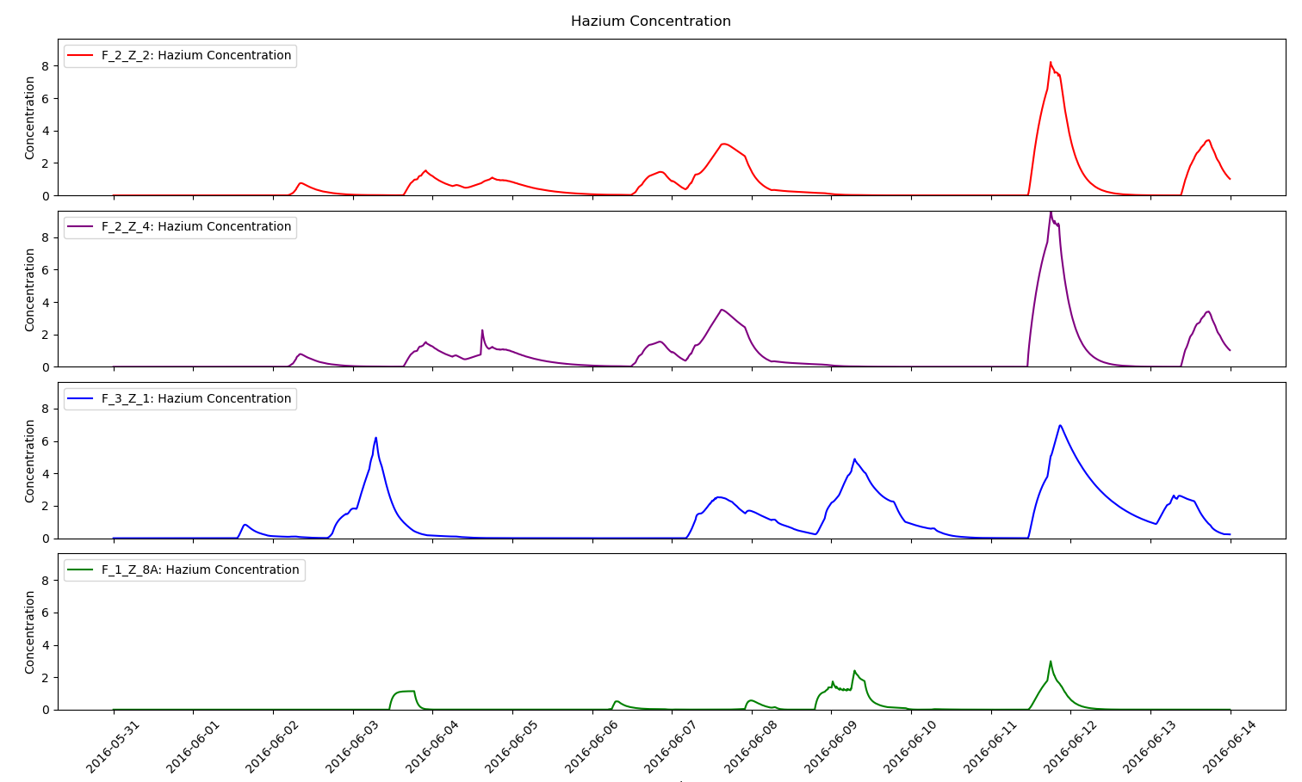
Visualization - Hazium Data
Hazium Data - Data Spikes on 3rd, 7th, 8th and 12th June

Slide 11
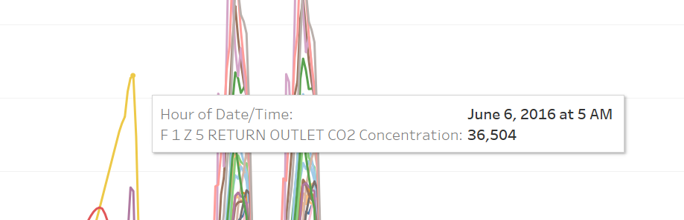
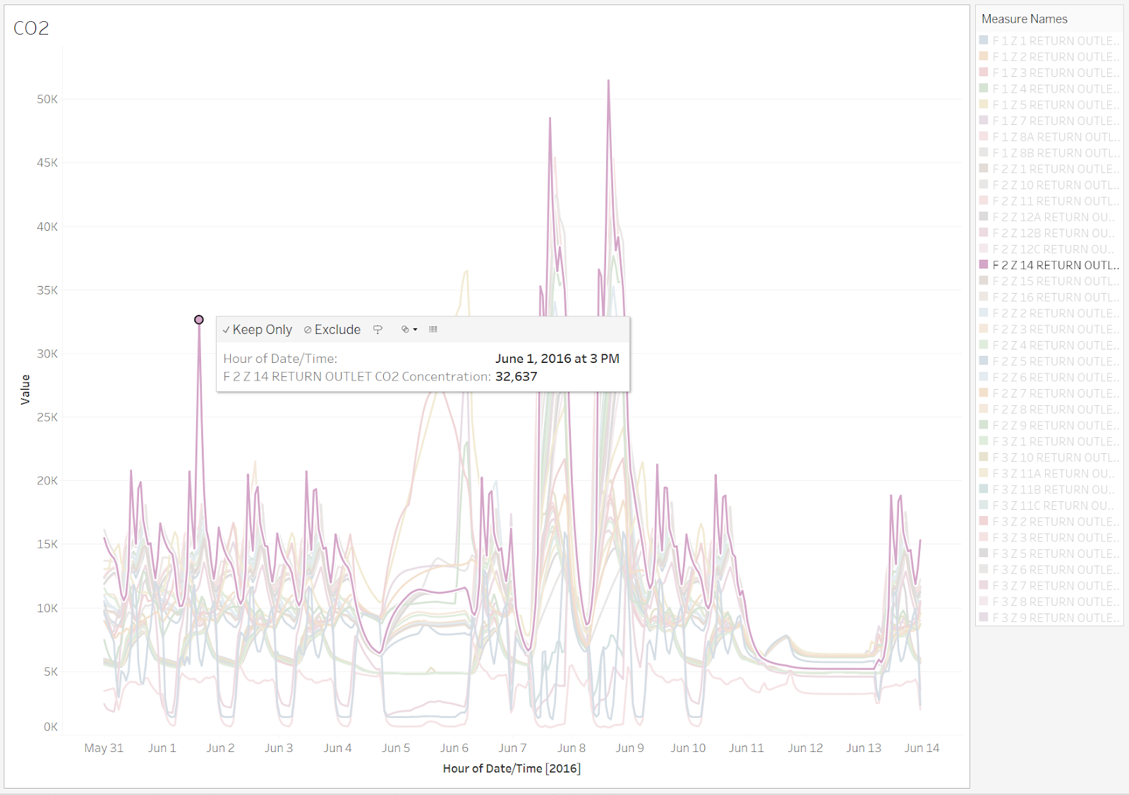
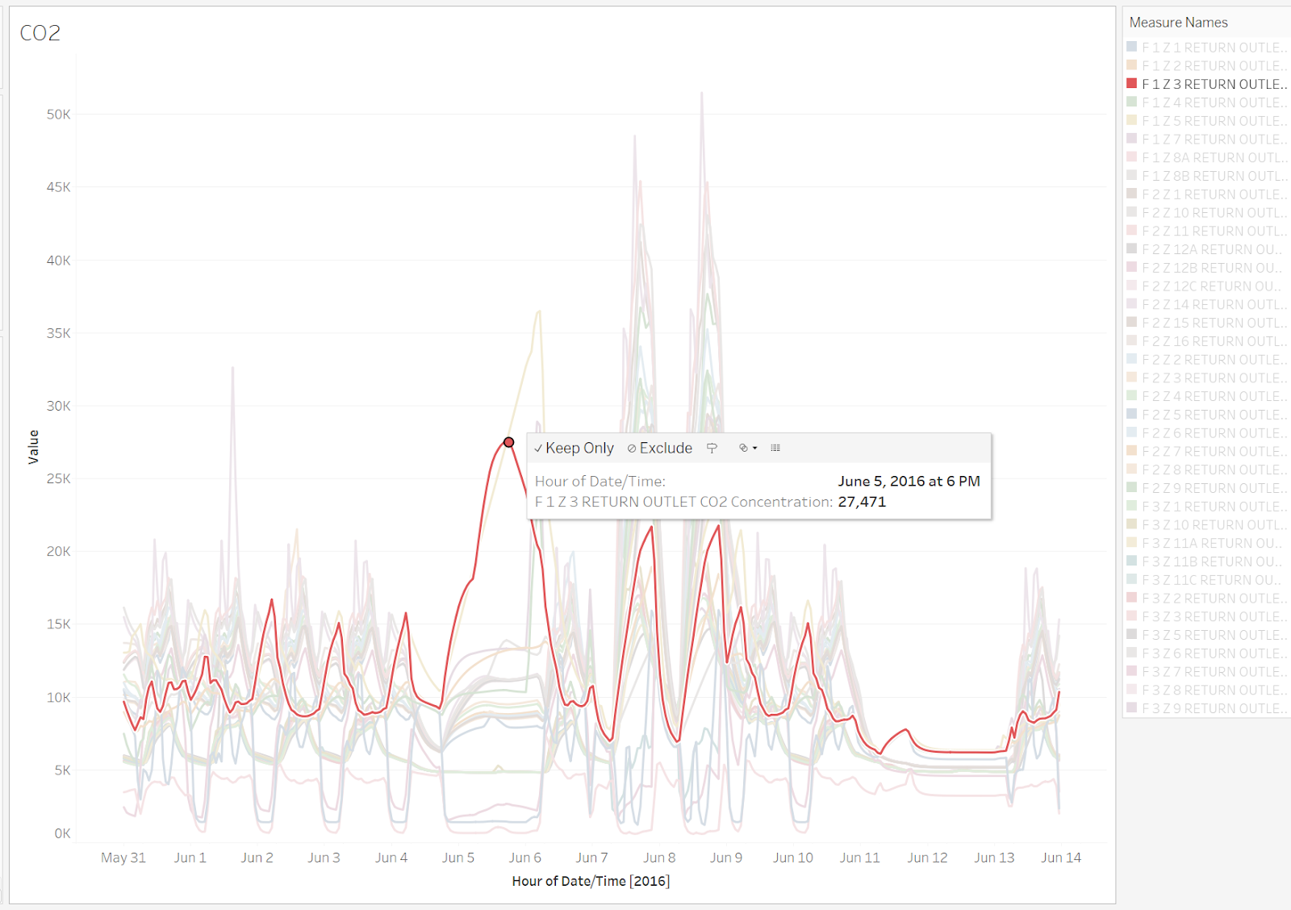
Visualization - CO2
CO2 Readings by Zone - Depicting unusual spikes.

Slide 12
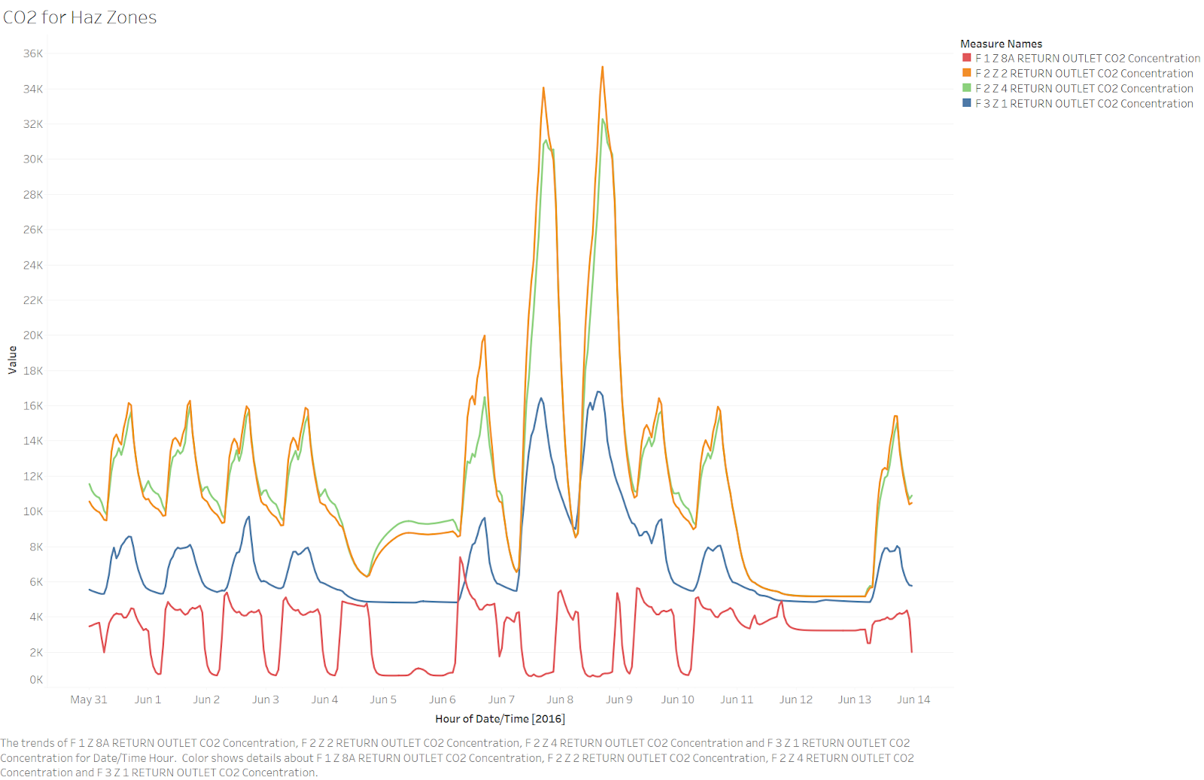
Visualization - CO2
CO2 Readings for Hazium Zones - Similar spikes.

Slide 13
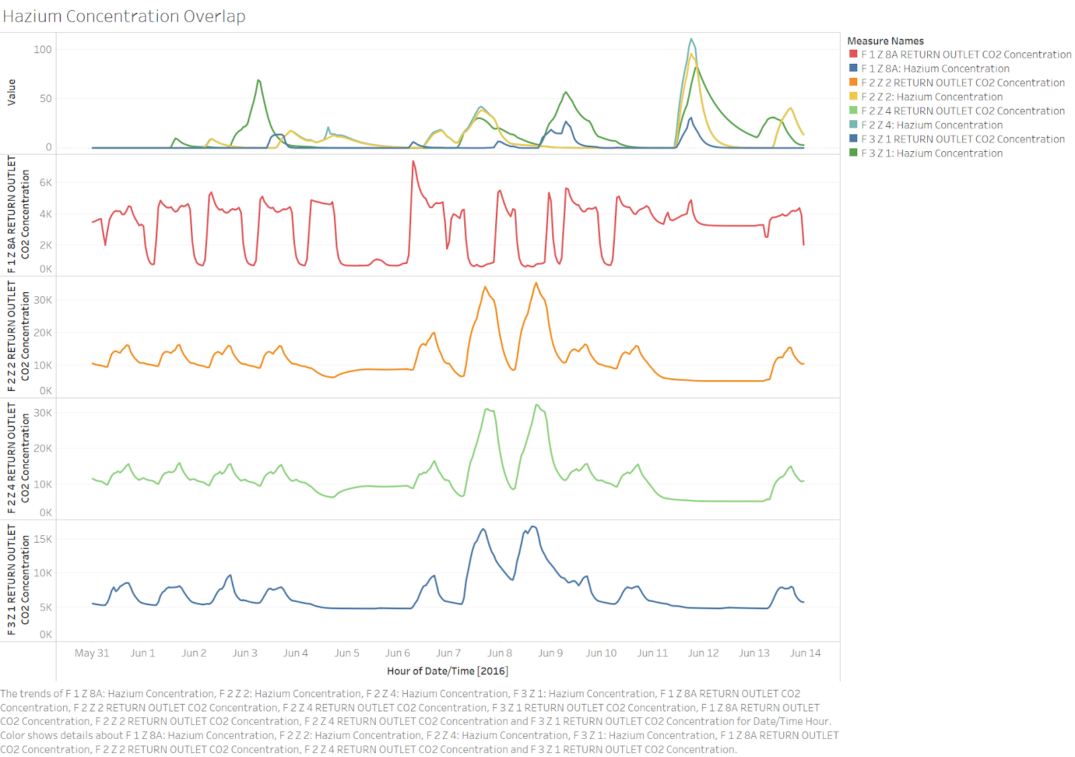
Visualization - Hazium Data
Hazium Data - Compared to CO2

Slide 14
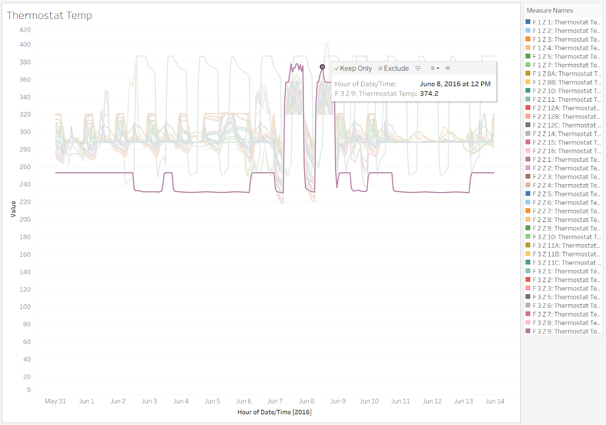
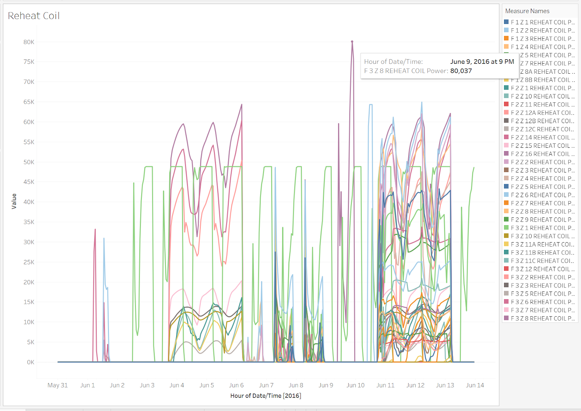
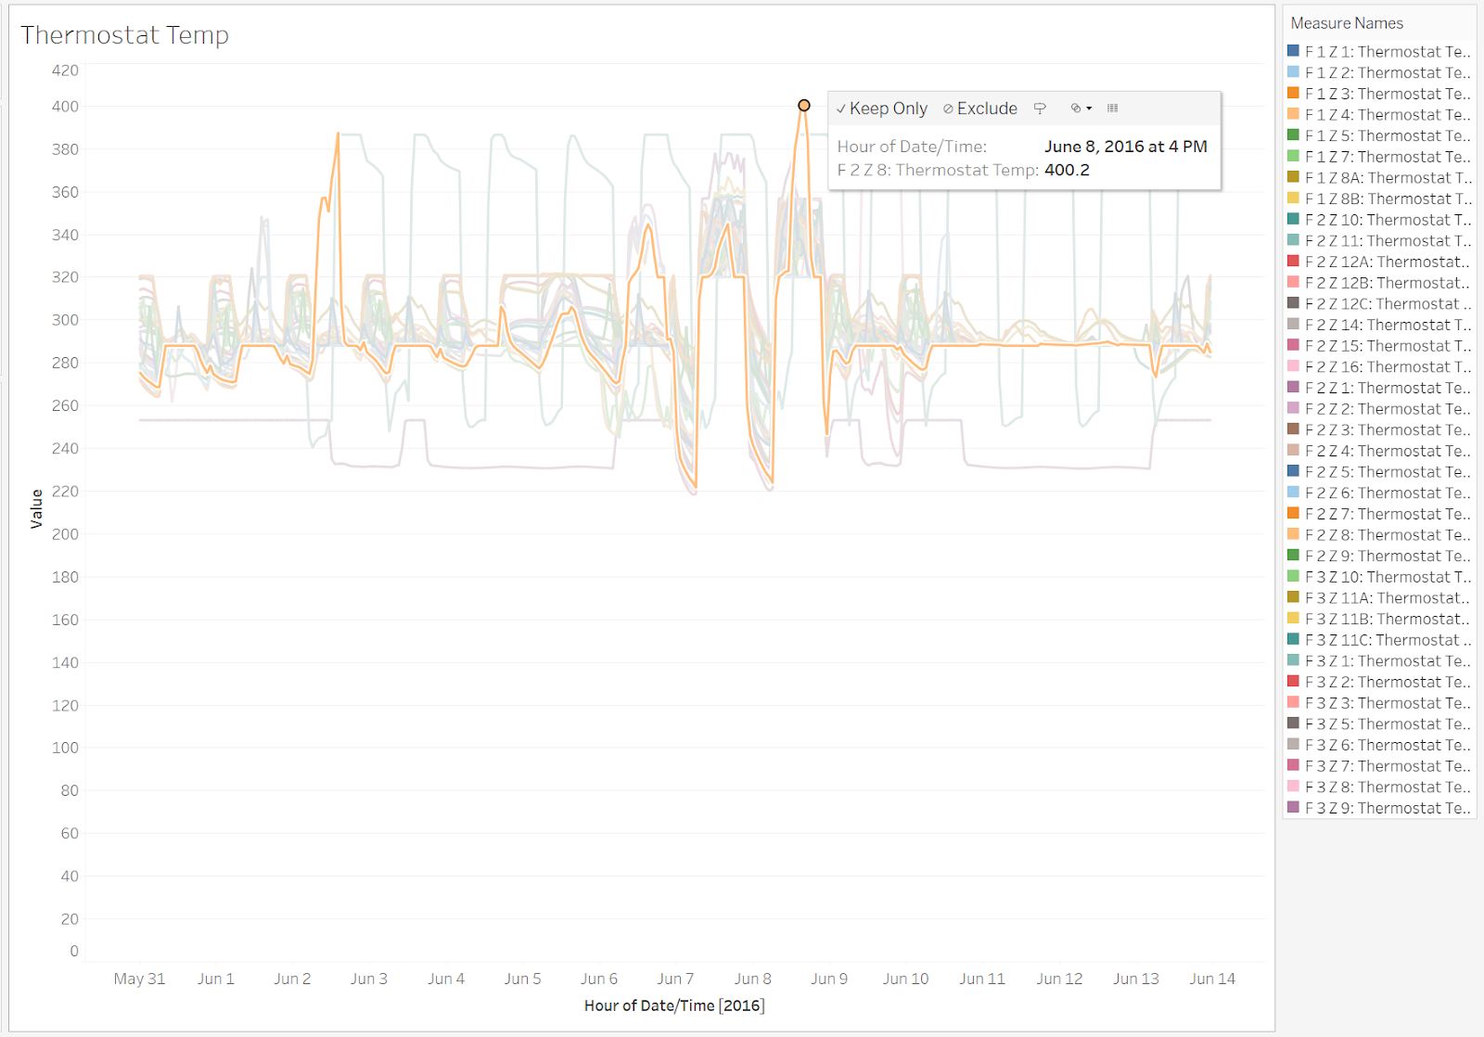
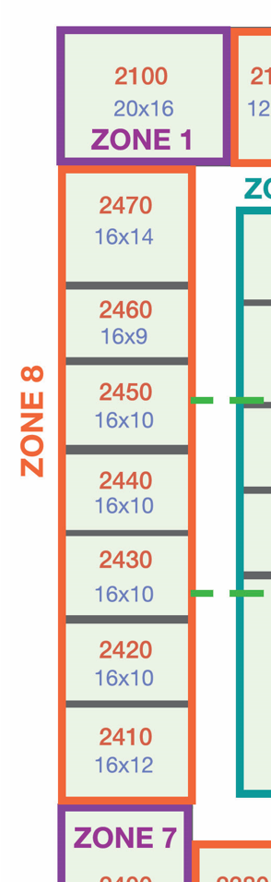
Other Interesting Insights
Other data that shows unusual readings on the 7th and 8th June.

Slide 15
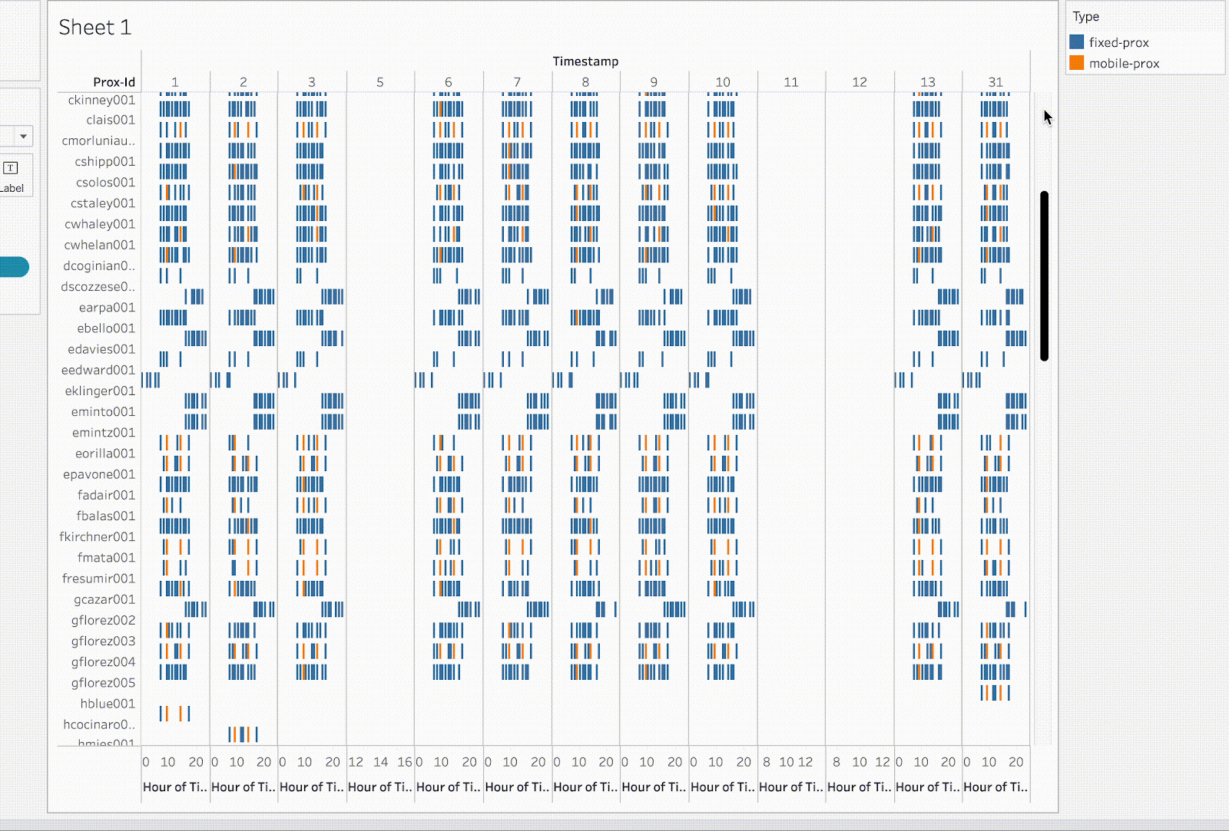
Employee Pattern - Visualization
Graph showing the prox card data for each employee by date and hour.

Slide 16
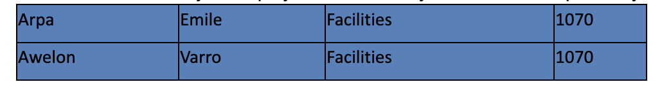
Employee Pattern - Analysis
Typically employees work from around 8 AM till 5 PM on weekdays.
Some employees mostly from IT department work in the later shift starting at 4 PM.
Very few employees from Facilities work throughout the night starting from midnight.

Slide 17
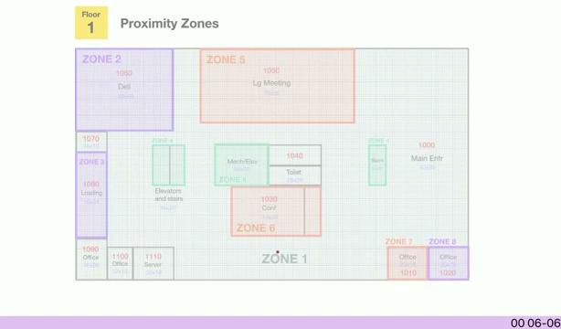
Visualization - Varro Awelon’s movement

Slide 18
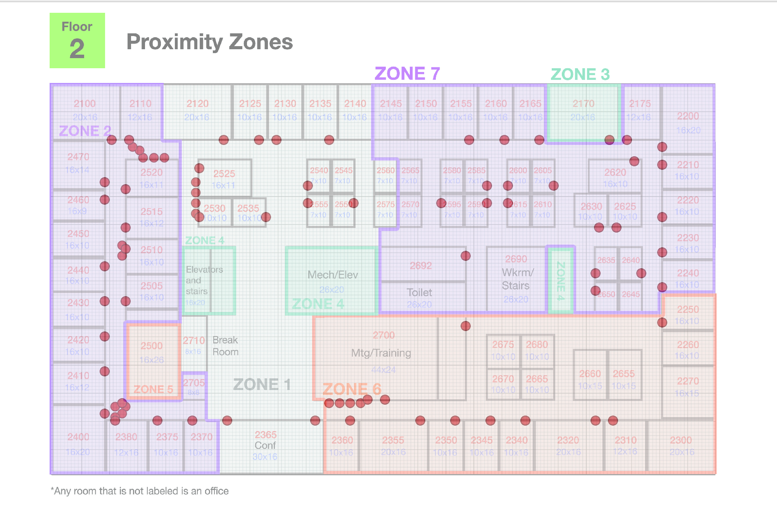
Visualization - Data from Rozie

Slide 19
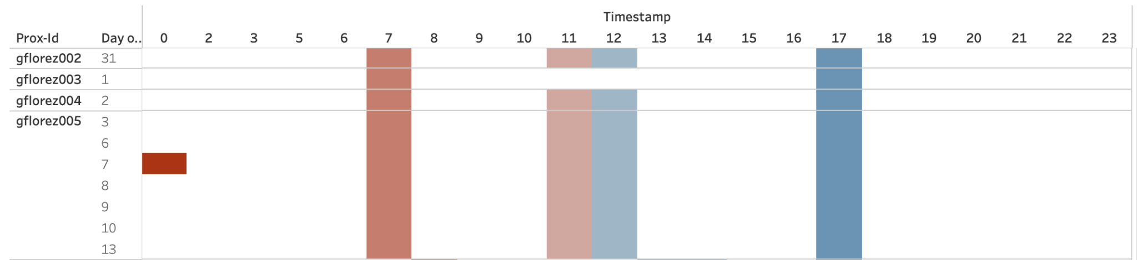
Anomalies
Employees are issued back-up prox cards if they misplace the original. Geneviere Florez has been issued 4 backup cards which indicates their carelessness or can be an anomaly that should be looked into. There is an unusual mid-night activity on 7th june as well.

Slide 20
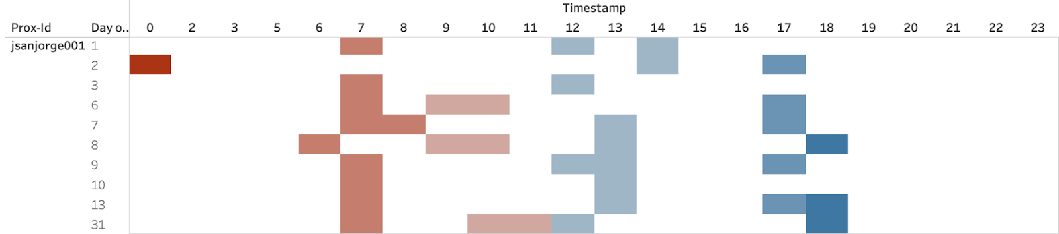
Anomalies
Executive Sten Sanjorge Jr., on premises at the unusual time of 12:00 AM who typically works from 7 AM to 5PM.

Slide 21
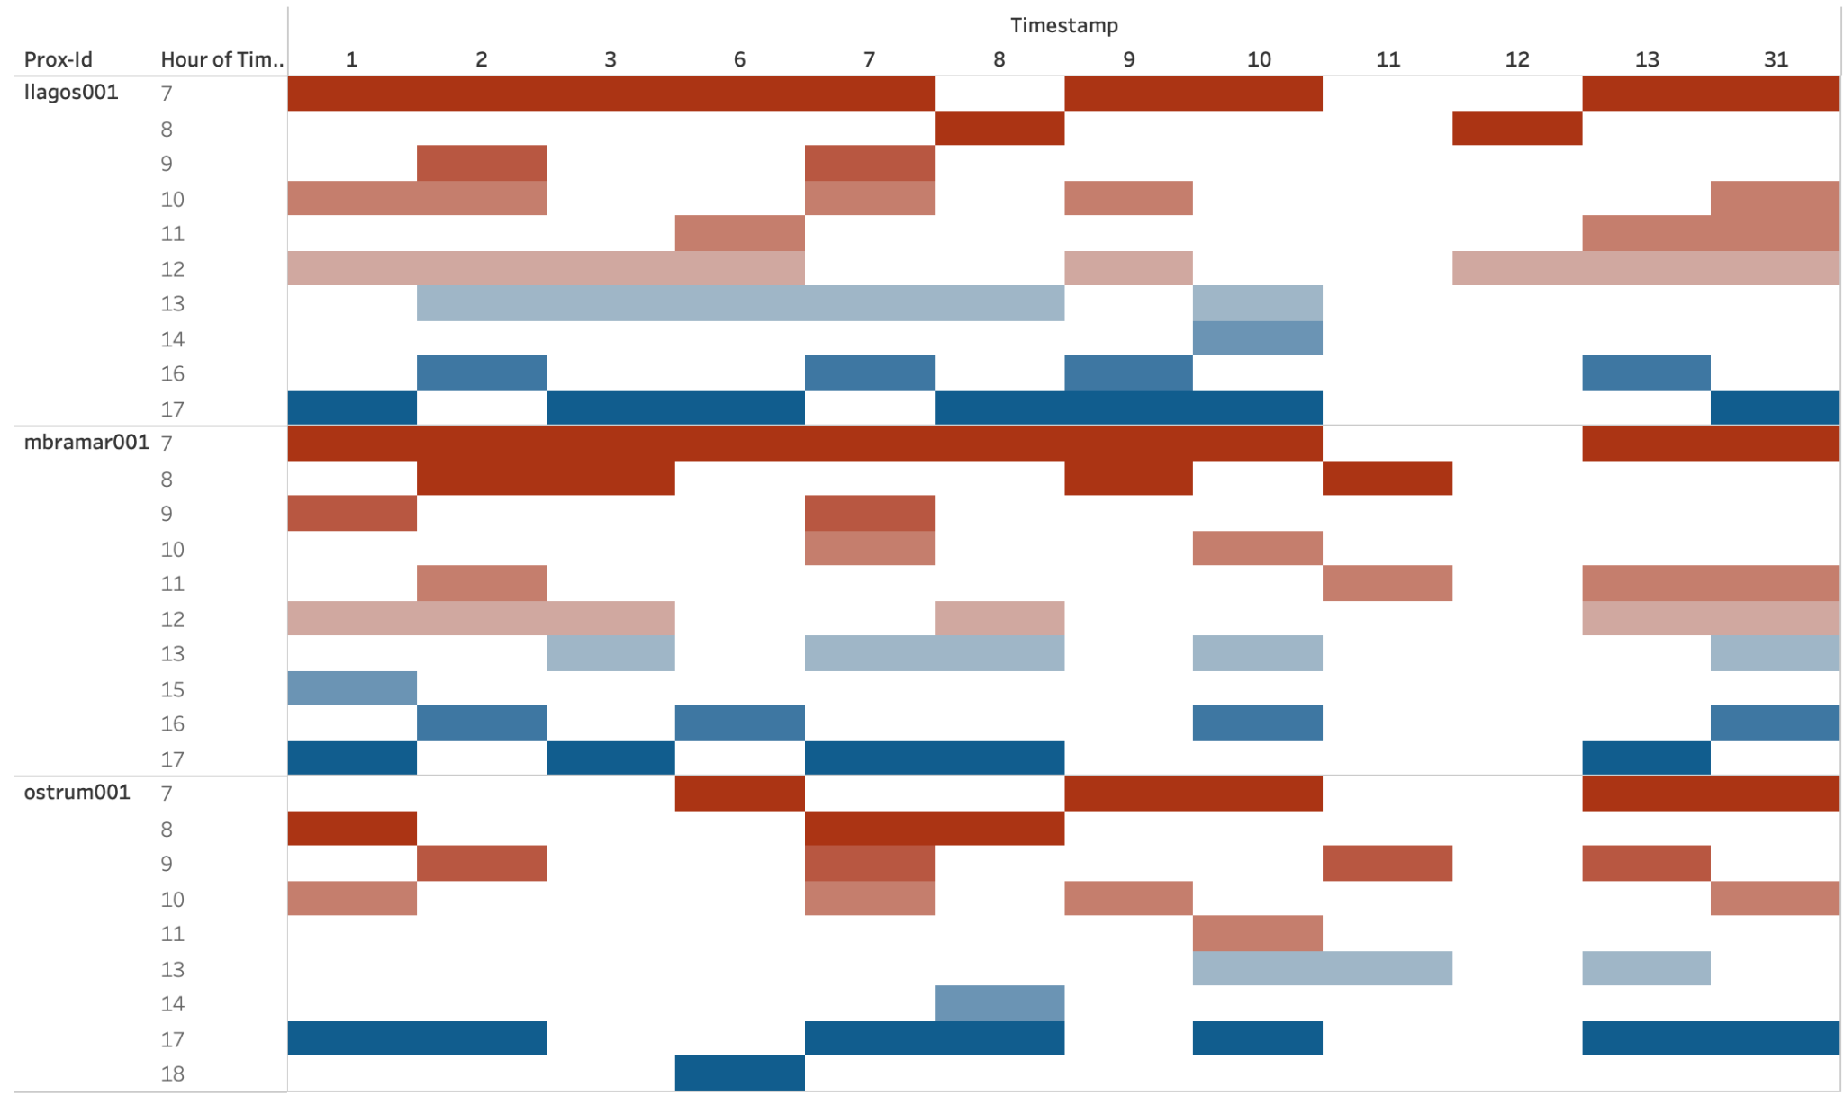
Anomalies - Proximity Sensors
Employees Mat Bramar, Linda Lagos, and Orhan Strum have unusual weekend activity in the office.

Slide 22
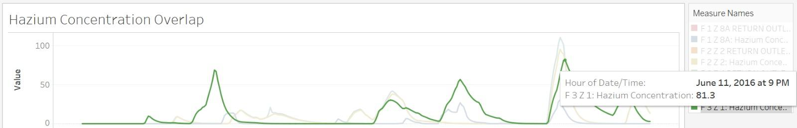
Observed Relationship between Prox Card Data and Hazium Data
A record high of Hazium concentration was observed on 11th June which is a Saturday after a few hours of Mat Bramar and Orhan Strum’s departure from the office. A weekend activity in the office is not usual and aligned with this high concentration of hazium, this activity should be further investigated.

Slide 23
Conclusion:
Analyzing the provided data has yielded valuable insights into employee patterns
and identification of anomalies within the employee patterns.
Addressing these anomalies can lead to increased security and avoid breaches further.
Future Scope:
Employing clustering techniques to club the similar patterns of the employee movement together.
The coordinates of fixed proximity sensors could help in further investigation.

